Slide 1


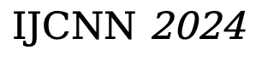
Hierarchical Mutual Information Analysis:
Towards Multi-View Clustering
in the Wild
*
Jiatai Wang, Zhiwei Xu , Xuewen Yang, Xin Wang, Li Tao
$IJCNN$ 2024

Slide 2

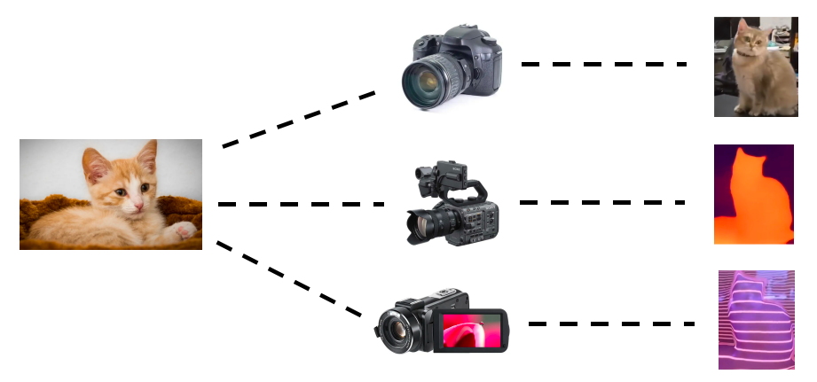

Background
- Data may consist of multiple modalities or views.
Image
研究目的
A gentleman is really
playing the piano
Text

Slide 3
Background
- Single-view/modal methods cannot utilize the information from multiple views/modals.

Slide 4
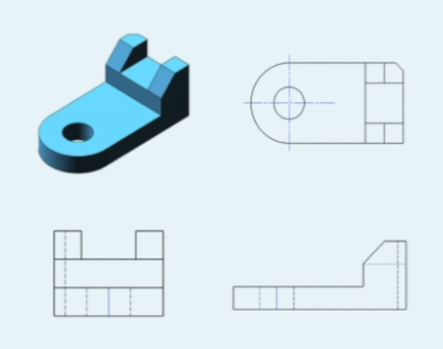

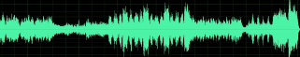
Background
- Single-view/modal methods cannot utilize the information from multiple views/modals.
With all three-view drawing, theobjects can be completely modeled.
By combing the video and the audio,we can understand what are theytalking and who is/are talking now.

Slide 5
Background
- Single-view/modal methods cannot utilize the information from multiple views/modals.
With all three-view drawing, theobjects can be completely modeled.
By combing the video and the audio,we can understand what are theytalking and who is/are talking now.
●Thus it is highly expected to develop the multi-view/modals analysis methods, esp, unsupervised ones.

Slide 6
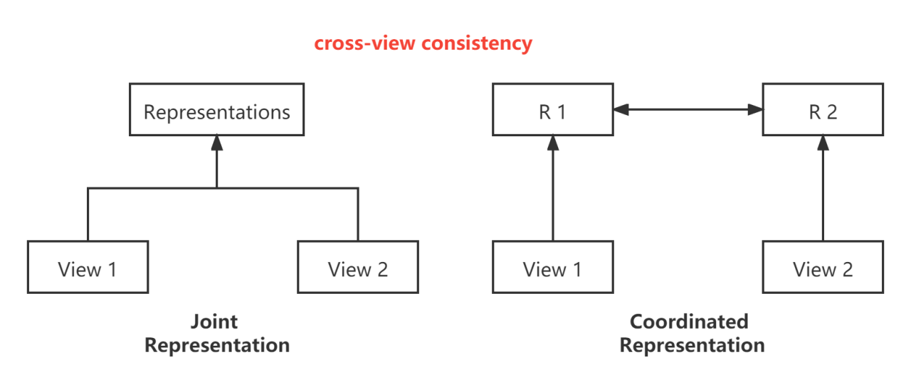
Observations & Motivation
- Multi-view Learning

Slide 7
Observations & Motivation
- Multi-view Learning
●Either of JR and CR explicitly use cross-view consistency which implicitly satisfies:Completeness of data

Slide 8
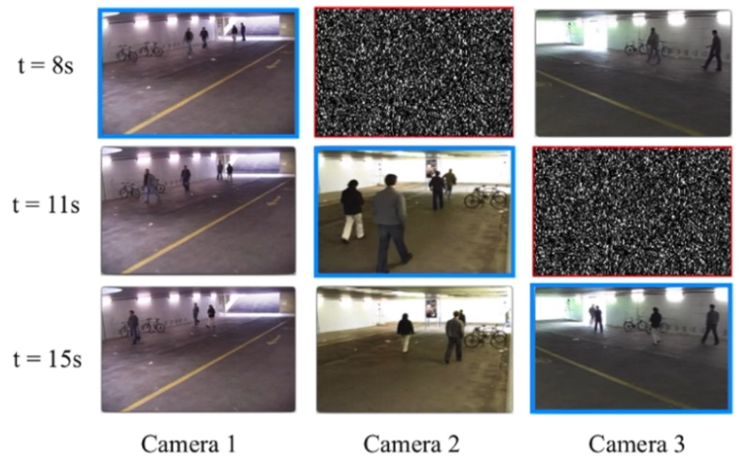
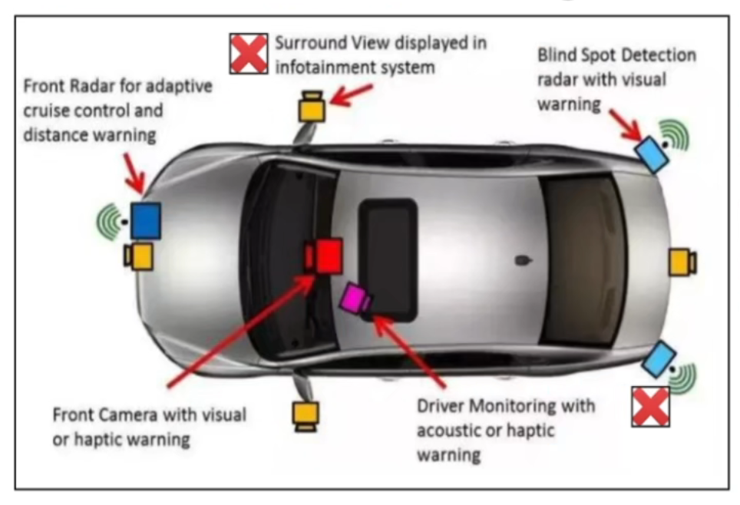
Background
- Completeness of data
- It requires that all examples appear in all views
- Multi-view clustering is attracting more and more attention as an important method for multi-view
problems.

Slide 9
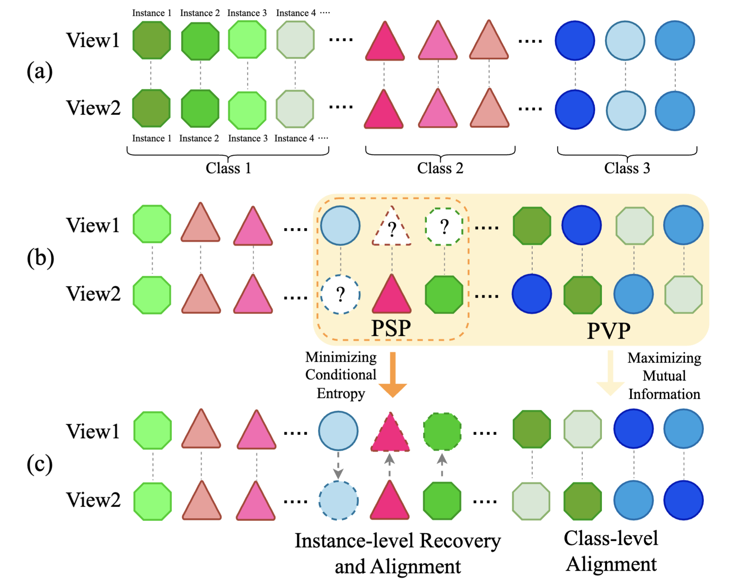
Challenges of Multi-View Clustering
- PVP:
Partially View-unaligned Problem
- PSP:
Partially Sample-missing Problem

Slide 10
Related Work
● In past works, researchers have achieved substantial progress in addressing PSP using various methods . PVP remains a relatively unexplored issue despite these advancements, as highlighted in recent studies . However, PVP can only find the optimal alignment path using the traditional Hungarian algorithm . Subsequently, PVC has implemented differentiable Hungarian algorithms, and MvCLN has achieved the class-level alignment using robust contrast loss. Although SURE has extended the filling of missing views based on MvCLN, class-level imputation does not provide detailed information about the data samples, and the quality of the alignment directly relies on the performance of the imputing, which increases the risk to use the features learned on the mistaken samples.
[1, 2, 3]
[4]
[5]
[6]
[7]
[1] Completer: Incomplete multi-view clustering via contrastive prediction, in CVPR, 2021.
[2] Multiview clustering with incomplete views, in NIPS, 2010.
[3] Cdimc-net: Cognitive deep incomplete multi-view clustering network, in Proceedings of the Twenty-Ninth International, 2021.
[4] Improving the hungarian assignment algorithm, in Operations Research Letters, 1986.
[5] Partially view-aligned clustering, in NIPS, 2020.
[6] Partially view-aligned representation learning with noise-robust contrastive loss, in CVPR, 2021.
[7] Robust multi-view clustering with incomplete information, in TPAMI, 2022.

Slide 11
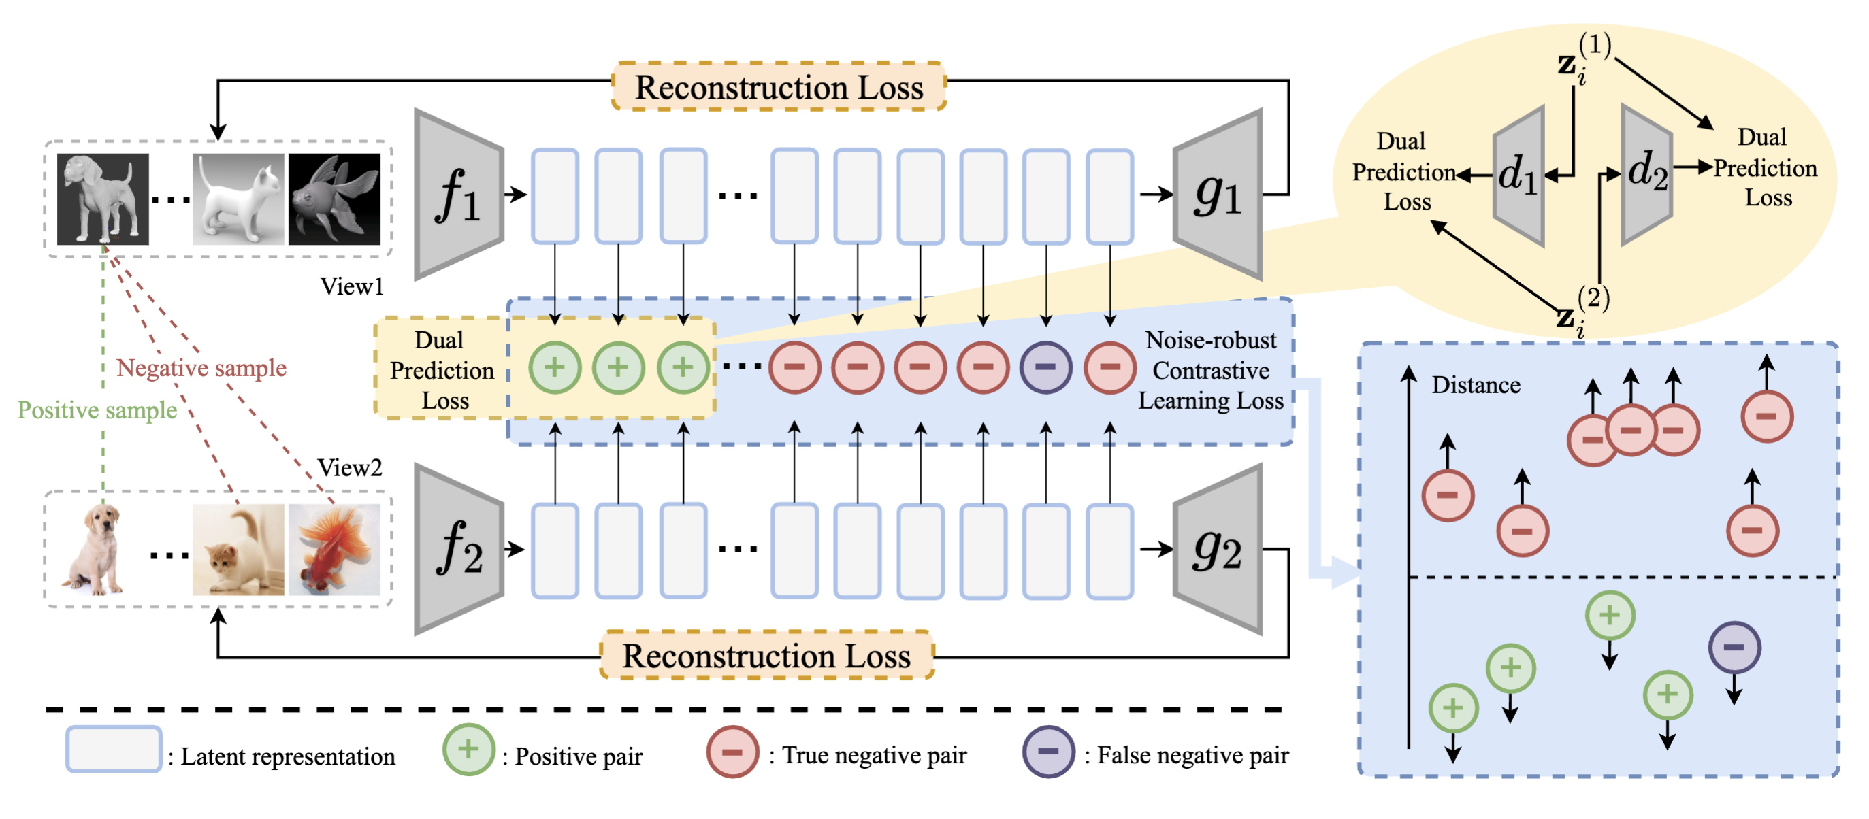
The Propose Method HmiMVC

Slide 12
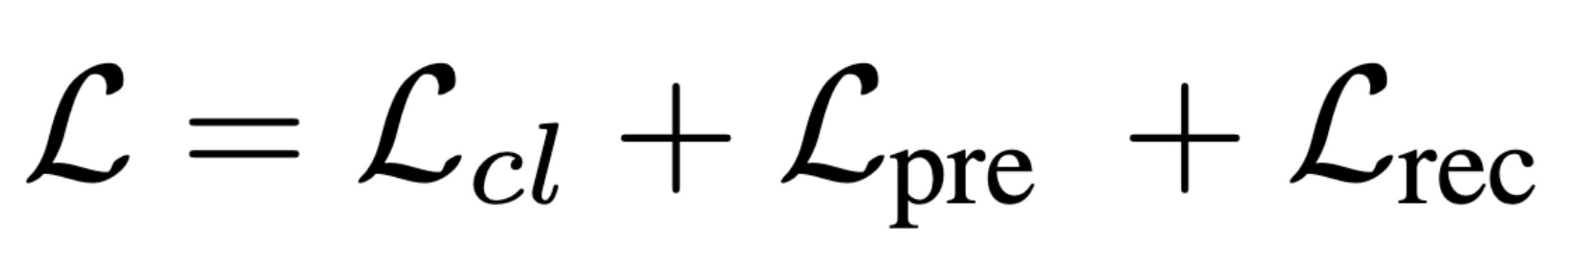
The Propose Method HmiMVC
- HmiMVC implements class-level alignment and instance-level filling at different hierarchies, respectively, and it consists of three learning objectives:
- I.e., noise-robust contrastive learning, dual prediction, and reconstruction. Specifically, the noise-robust contrastive learning objective learns class-level alignment relations from aligned positive and unaligned negative samples. Dual prediction allows for constructing instance-level alignment and recovering missing views from one of its existing views. The goal of reconstruction loss is to maintain the diversity of views and project all views into view-specific spaces.

Slide 13
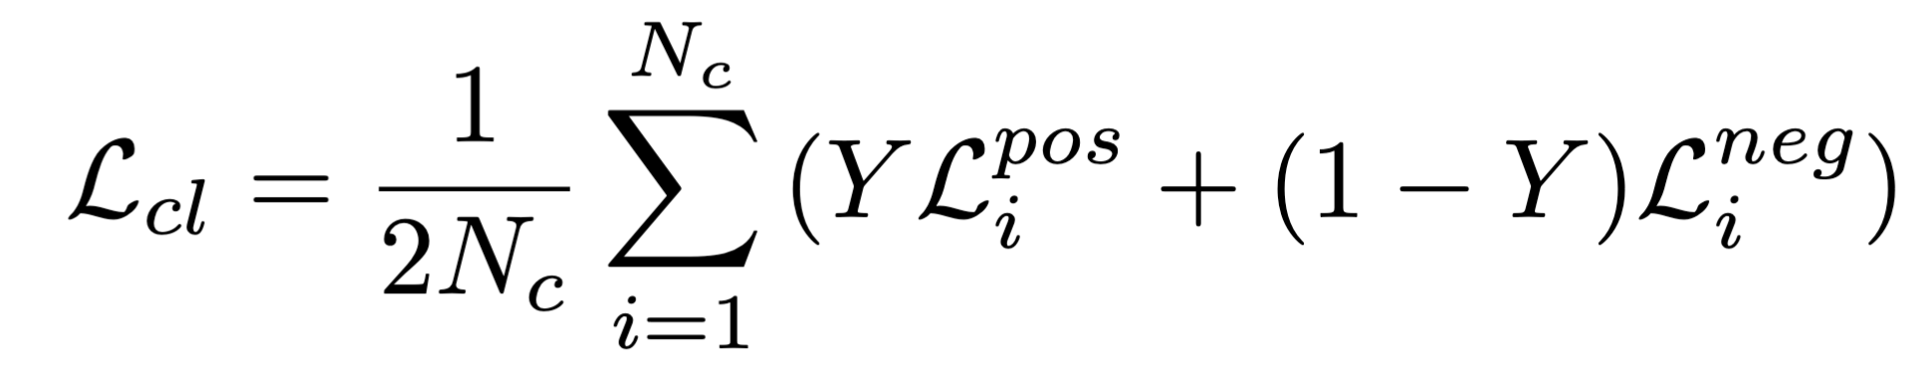
Class-level Alignment

Slide 14
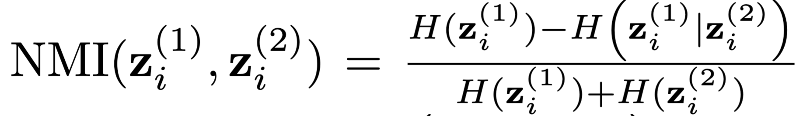
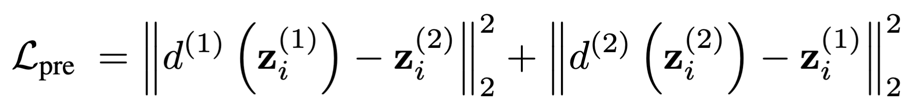
Instance-level Recovery and Alignment

Slide 15
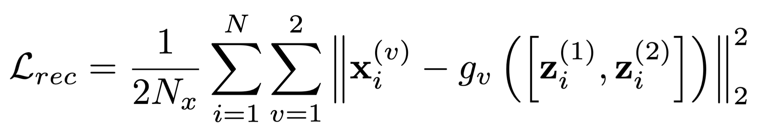
Reconstruction for Hierarchical Consistencies

Slide 16
Experiments
- Baselines
● Completer: Incomplete multi-view clustering via contrastive prediction (COMPLETER) (Lin et al., 2021)
● Partially view-aligned representation learning with noise-robust contrastive loss (MvCLN) (Yang et al., 2021)
● Robust multi-view clustering with incomplete information (SURE) (Yang et al., 2022)
- Datasets
● Scene-15
● Deep Animal
● MNIST-USPS
● Caltech101-20

Slide 17
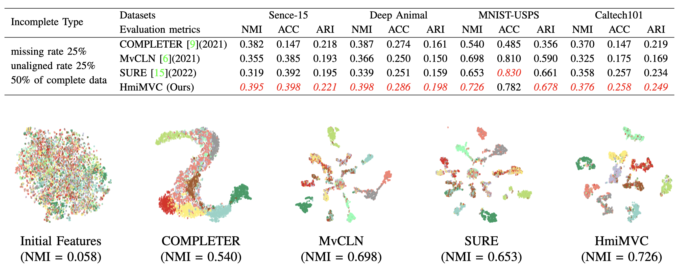
Experiments
- Comparison with the State-of-the-art

Slide 18
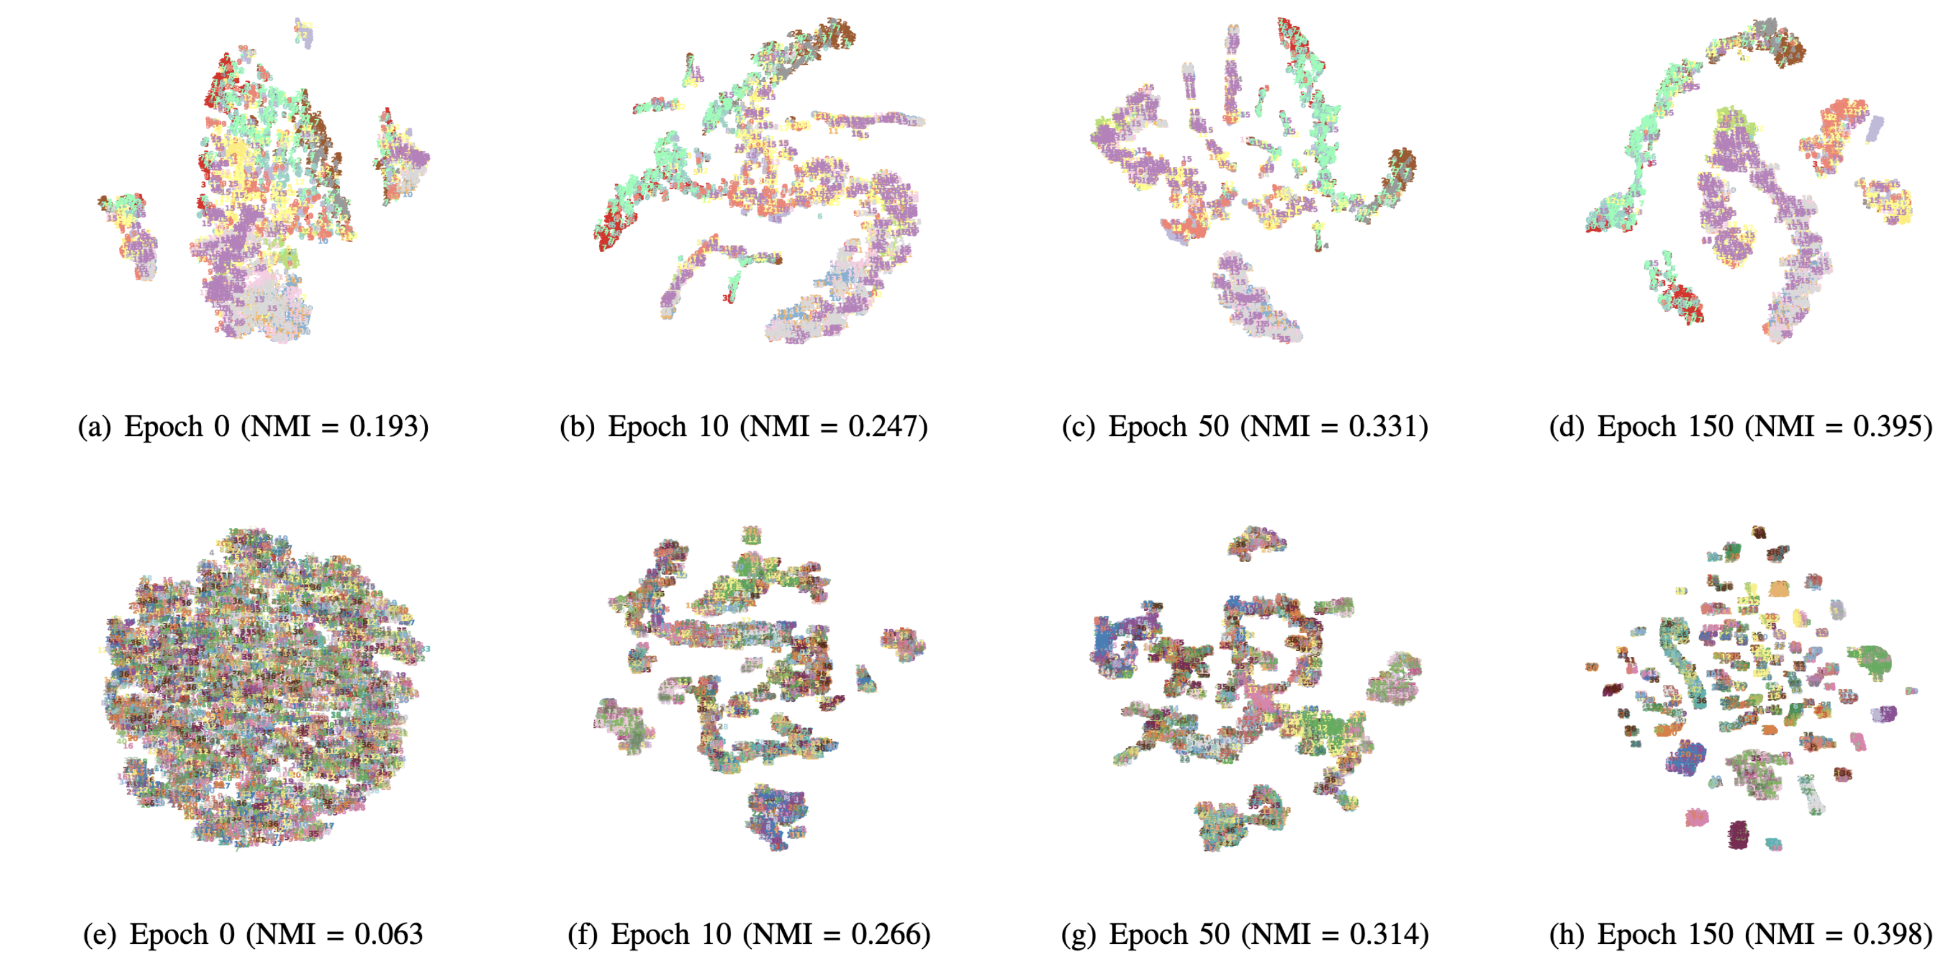
Experiments
- Convergence Analysis

Slide 19
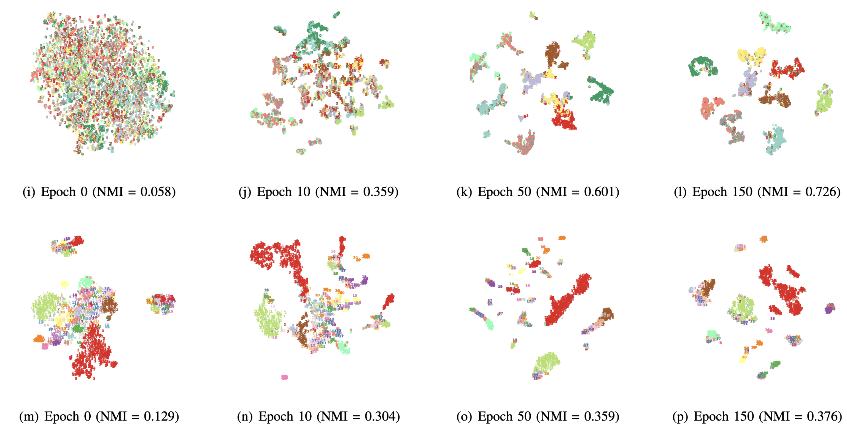
Experiments
- Convergence Analysis

Slide 20
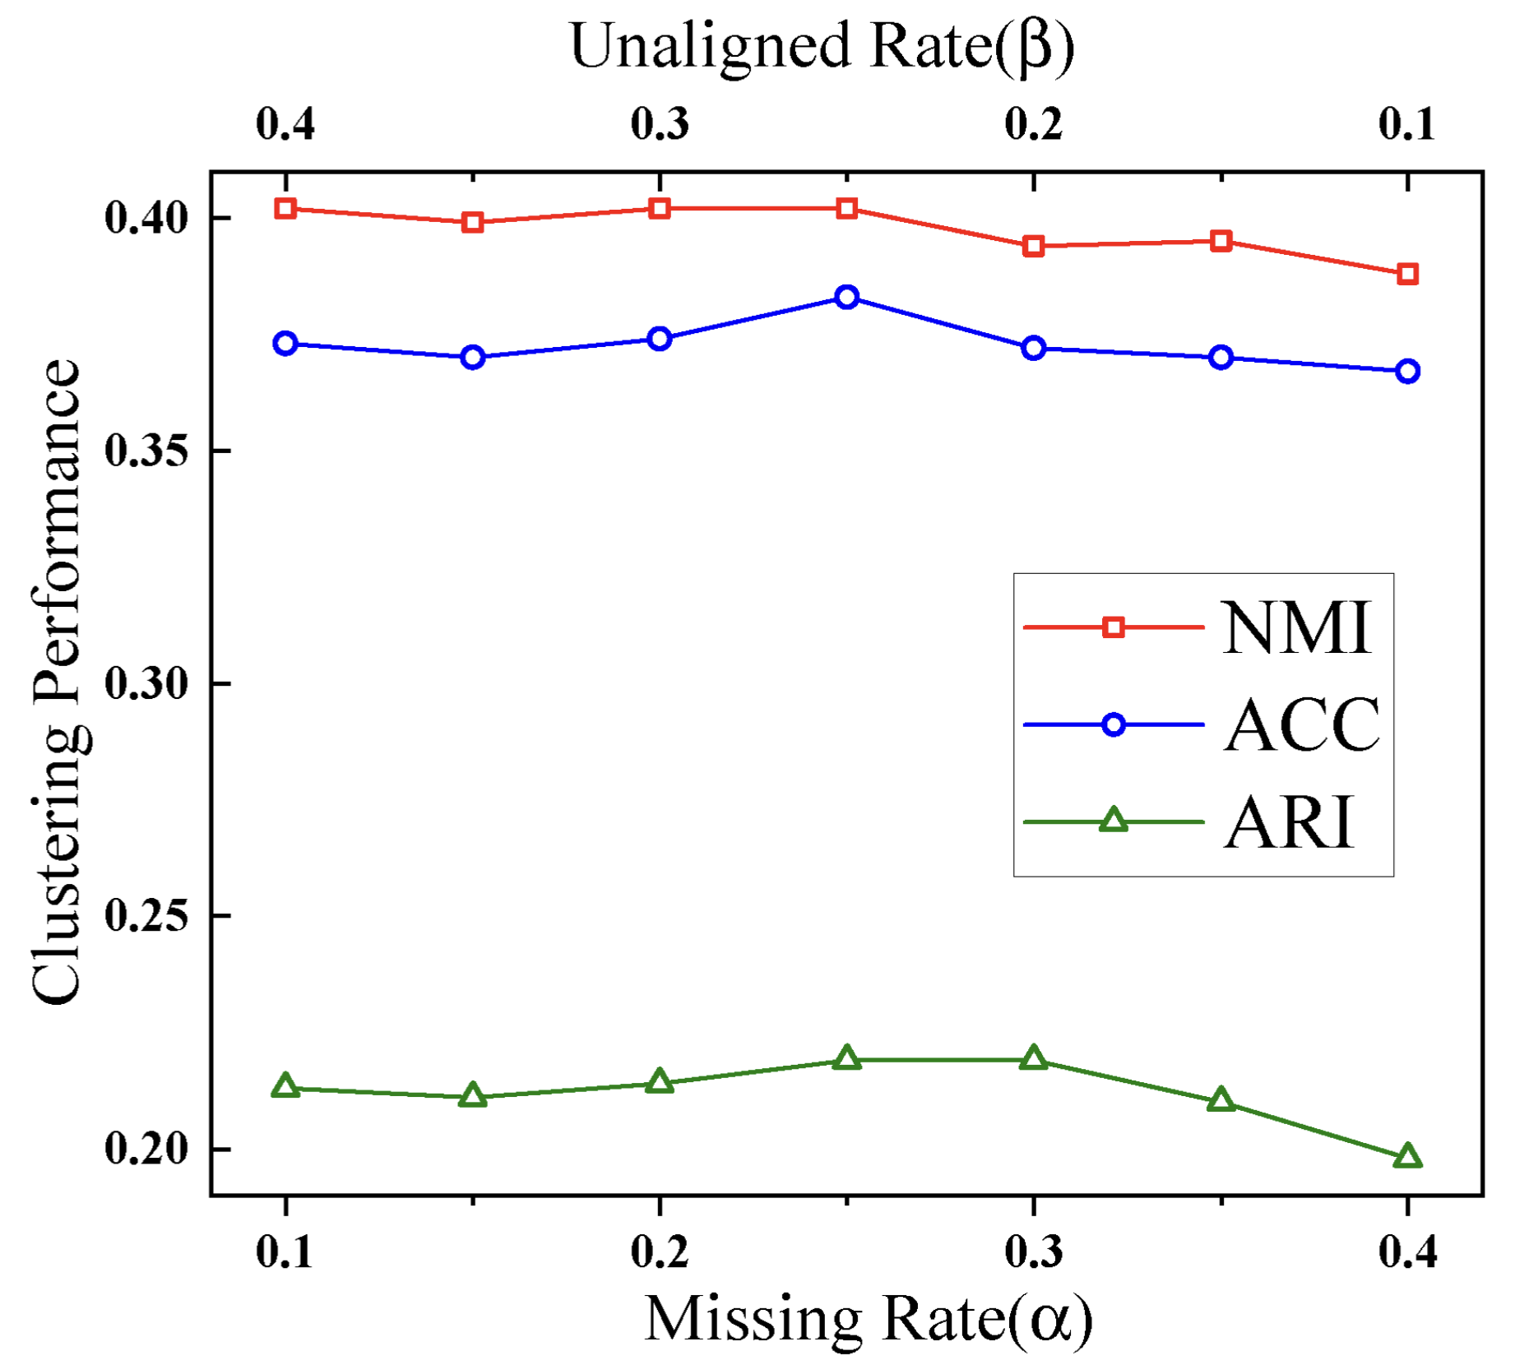
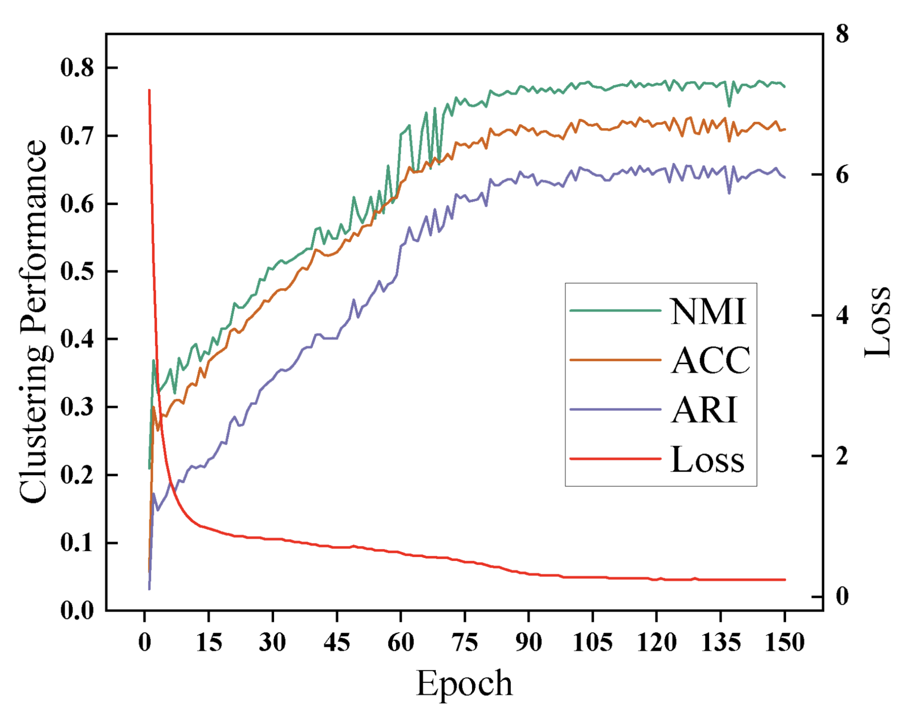
Experiments
- Convergence Analysis
- Parametric Analysis

Slide 21
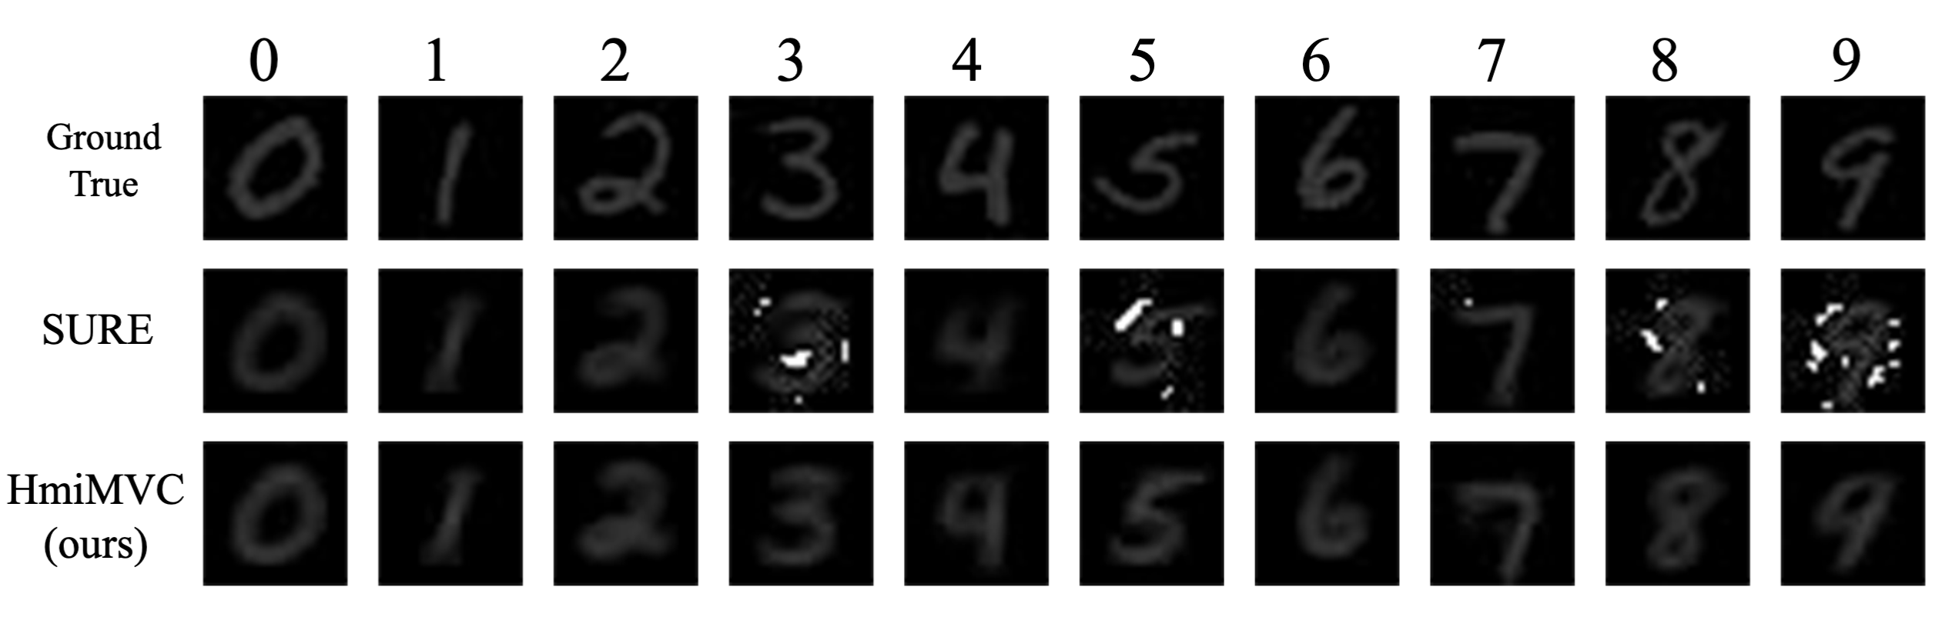
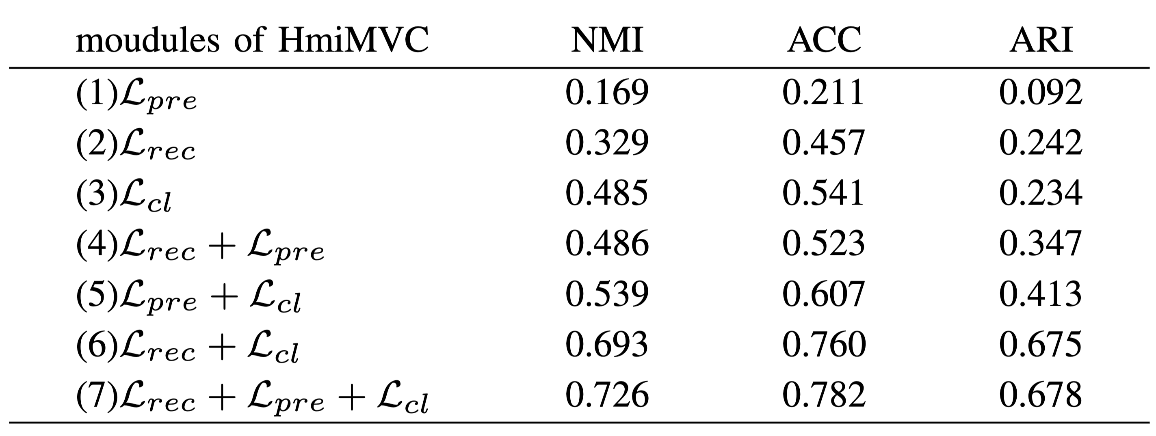
Experiments
- Data recovery on noisy MNIST UPS datasets.
- Ablation study

Slide 22
Thanks for your attention!

